Slide 1


INDIAN INSTITUTE OF SCIENCE EDUCATION AND RESEARCH, BHOPAL
Department Of Electrical Engineering and Computer Sciene
MODULE 3 - FOURIER SERIES REPRESENTATION OF PERIODIC SIGNALS

Slide 2
MODULE 3 : FOURIER SERIES REPRESENTATION OF PERIODIC SIGNALS
CONTENT
  HARMONICALLY RELATED COMPLEX EXPONENTIALS
  THE FOURIER SERIES REPRESENTATION
  TRIGONOMETRIC FORM OF THE FOURIER SERIES
  CONVERGENCE OF THE FOURIER SERIES
  PROPERTIES OF THE CONTINUOUS-TIME FOURIER SERIES
  DISCRETE-TIME FOURIER SERIES (DTFS)
  PROPERTIES OF THE DISCRETE-TIME FOURIER SERIES
  THE GIBBS PHENOMENON
  FOURIER SERIES AND LTI SYSTEMS
  FILTERING

Slide 3
Harmonically Related Complex Exponentials
A set of harmonically related complex exponentials is a set of periodic exponentials with fundamental frequencies that are all multiples of a single positive frequency ω₀.
φk(t) = ejkω₀t, k = 0, ±1, ±2, …
Each φk(t) has fundamental frequency kω0 and is periodic with period 2π/(kω0). Since each is periodic with period
T = 2π/ω0, any linear combination is also periodic with period T.
  General Form
x(t) = ∑k=-∞ ∞ ak ejkω₀t

Slide 4
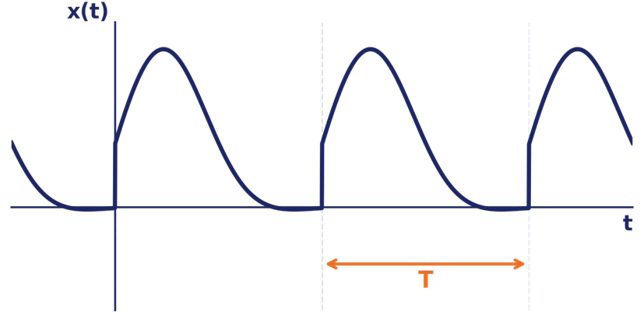

A periodic signal x(t) with period T built as a sum of complex exponentials at integer multiples of ω₀ = 2π/T
k = 0: DC / constant term a₀
k = ±1: Fundamental component
k = ±N: Nth harmonic component

Slide 5
The Fourier Series Representation
If a periodic signal x(t), with period T and fundamental frequency ω₀ = 2π/T, satisfies the Dirichlet conditions, it can be expressed as:
SYNTHESIS EQUATION
x(t) = ∑k=-∞∞ akejkω0t
Reconstructs x(t) from its Fourier coefficients ak
ANALYSIS EQUATION (EULER FORMULA)
ak = 1/T ∫Tx(t) e-jkω₀t dt
Computes coefficients ak by integrating over one period T

Slide 6
The Fourier Series Representation
We have written equivalent expressions for the Fourier series in terms of the fundamnetal frequency ω0 and the fundamental period T. Equation (1) is referred to as the synthesis equation and eq. (2) as the analysis equation. The set of coefficients {ak} are often called the Fourier series coefficients or the spectral coefficients of x(t).
Key Points
  a₀ is the average value (DC component) of x(t) over one period: a₀ = (1/T) ∫T x(t) dt.
  ak & a-k are related by a-k = ak*(complex conjugates) whenever x(t) is real-valued.
  |ak| gives the magnitude spectrum; ∠ak gives the phase spectrum — together, the line spectrum of x(t).

Slide 7

Trigonometric Form of the Fourier Series
For a real periodic signal x(t), the complex exponential form can be rewritten using sines and cosines:
Combined Sine-Cosine Form :
Amplitude phase form :
x(t) =
a₀ + ∑k=1∞ 2|ak|cos(kω0t+ ∠ak)
x(t) =
a₀ + ∑k=1∞ [Bk cos(kω0t) + Cksin(kω0t)]
Most useful form for interpreting amplitude and phase spectra of a real signal
where Bk = ak + a-k = 2Re{ak}, Ck = j(ak − a-k) = −2Im{ak}
Special Cases (Real & Even / Real & Odd Signals)
If x(t) is real & EVEN
If x(t) is real & ODD
x(t) = a₀ + ∑k=1∞ 2ak cos(kω0t)
x(t) = ∑k=1∞ 2j·Im{ak} sin(kω0t)
Only cosine terms appear (ak is real)
Only sine terms appear (ak is purely imaginary); a₀ = 0

Slide 8
Convergence of the Fourier Series
Not every periodic signal has a Fourier series that converges to x(t) exactly. Oppenheim presents two classes of sufficient conditions:
CONDITION A — FINITE ENERGY
One class of periodic signals that are representable through the Fourier series is those signals which have finite energy over a single period, i.e., signals for which
∫T |x(t)|² dt < ∞
CONDITION B — DIRICHLET CONDITIONS
Moreover, an alternative set of conditions, developed by P. L. Dirichlet and also satisfied by essentially all of the signals with which we will be concerned, guarantees that x(t) equals its Fourier series representation, except at isolated values oft for which x(t) is discontinuous.

Slide 9
Convergence of the Fourier Series
The Dirichlet conditions are as follows:
Condition 1. Over any period, x(t) must be absolutely integrable; that is, ∫t lx(t)l dt < ∞ .
Condition 2. In any finite interval of time, x(t) is of bounded variation; that is, there are no more than a finite number of maxima and minima during any single period of the signal.
Condition 3. In any finite interval of time, there are only a finite number of discontinu ities. Furthermore, each of these discontinuities is finite.

Slide 10
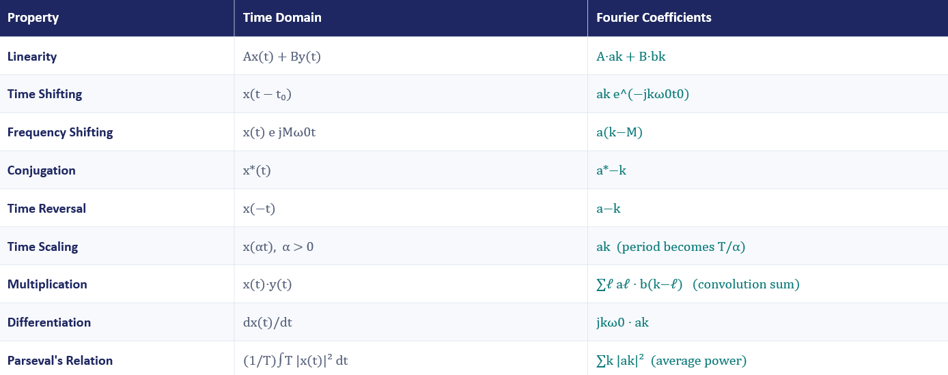
Properties of the Continuous-Time Fourier Series
x(t) ↔ ak and y(t) ↔ bk are Fourier series pairs, both periodic with period T

Slide 11
Discrete-Time Fourier Series (DTFS)
A discrete-time periodic sequence x[n] with period N and fundamental frequency ω0 = 2π/N can be represented as a sum of N harmonically related discrete-time exponentials:
SYNTHESIS EQUATION
x[n] = ∑k=<N> ak ejkω0n
Sum over any N consecutive values of k (a finite sum — only N distinct exponentials exist)
ANALYSIS EQUATION
ak = 1/N
∑n=<N> x[n] e−jkω0n
Only N distinct coefficients ak: a key difference from the CT case (infinite ak's)

Slide 12
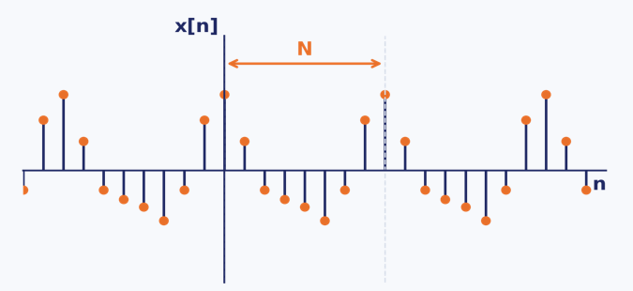
Key Differences from CT Fourier Series
  ak is periodic in k with period N: a(k+N) = ak
  Only N independent coefficients exist — the DTFS is a finite series, unlike the infinite CTFS
  <N> denotes any range of N consecutive integers (e.g. k = 0, 1, …, N−1)

Slide 13
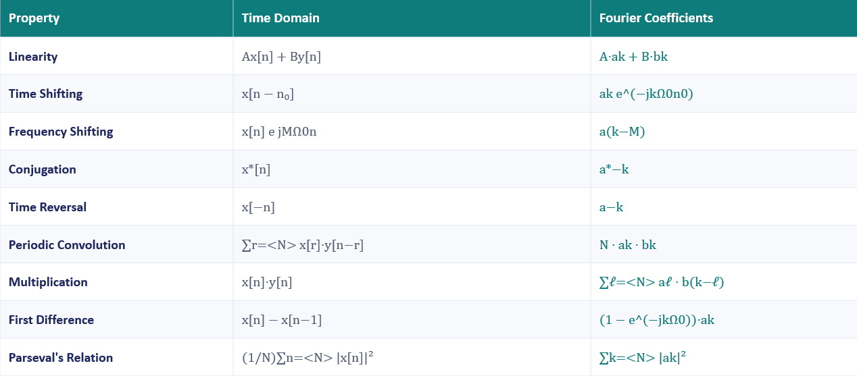
Properties of the Discrete-Time Fourier Series
x[n] ↔ ak and y[n] ↔ bk are DTFS pairs, both periodic with period N

Slide 14
The Gibbs Phenomenon
Named after: J. Willard Gibbs (1899), though first observed by Henry Wilbraham (1848). It is a fundamental limitation when truncating Fourier series for practical (finite-term) signal reconstruction and filter design.
When x(t) has a jump discontinuity, the partial sum xN(t) = ∑|k|≤N ak ejkω₀t always exhibits ripples (overshoot) near the discontinuity.
  As N increases, the ripples become more compressed near the edge but the peak overshoot does NOT vanish
  The overshoot converges to approximately 9% of the signal's jump size, regardless of how large N is
  Energy in the ripples → 0 as N → ∞, so convergence still holds in the mean-square (finite-energy) sense

Slide 15
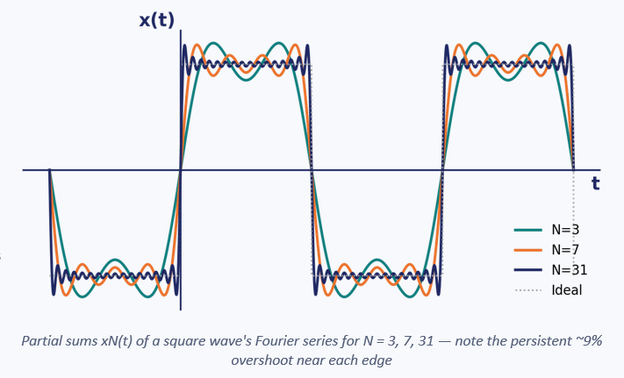

Slide 16



Fourier Series and LTI Systems
Complex exponentials are eigenfunctions of any LTI system. If the input is est, the output is H(s)·est — same shape, scaled by the system's eigenvalue H(s).
EIGEN FUNCTION PROPERTY
RESPONSE TO A PERIODIC INPUT
If x(t) = ∑k ak ejkω0t
ejkω0t → LTI System → H(jkω0)·ejkω0t
then y(t) = ∑k ak H(jkω0) ejkω0t
H(jkω0) = ∫-∞∞ h(t) e−jkω0t dt
The output is periodic with the SAME period; each coefficient is scaled by H at that harmonic
H(jkω0) is the system's frequency response, evaluated at the harmonic frequencies
System Block View
x(t)
= Σ ak e jkω0t
LTI SYSTEM
h(t), H(jω)
y(t)
= Σ ak H(jkω0) e jkω0t
This is the basis of frequency-domain analysis: filtering, frequency response design, and spectral shaping all rely on this relationship.

Slide 17
FILTERING
It is of interest to change the relative amplitudes of the frequency components in a signal or perhaps eliminate some frequency components entirely, a process referred to as filtering.
Linear time-invariant systems that change the shape of the spectrum are often referred to as frequency-shaping filters.
Systems that are designed to pass some frequencies essentially undistorted and significantly attenuate or eliminate others are referred to as frequency-selective filters.

Slide 18
FILTERING
EXAMPLES OF CONTINUOUS-TIME FILTERS DESCRIBED BY DIFFERENTIAL EQUATIONS:
  A Simple RC Lowpass Filter
  A Simple RC Highpass Filter
EXAMPLES OF DISCRETE-TIME FILTERS DESCRIBED BY DIFFERENCE EQUATIONS :
  First-Order Recursive Discrete-Time Filters
  Nonrecursive Discrete-Time Filters

Slide 19
Module - 3
Completed

